Slide 1
Chronic Lung Disease Management: Energy Conservation
Joyce Braun & Jared Booth
USASK Nursing Students in Partnership with Lung Saskatchewan
Notes:
Joyce

Slide 2
Introduction
Lung Sask:
Our Mission:
To improve lung health one breath at a time.
Our Vision:
Healthy lungs for everyone.
Our Commitment:
Improving respiratory health and quality of life through education, advocacy, and evidence-based research.
Joyce:
Fourth-year Nursing Student
Interested in working with the senior population
Mother of three and wife
Moved to Canada in 2017 from Kenya
Jared:
Fourth-year Nursing Student
Interested in working in mental health and emergency services
Brother and son
Lived in Saskatchewan my whole life
Instructors, Jaimie & Jill:
Certified Respiratory Educators and Registered Nurses at Lung Saskatchewan
Notes:
Joyce and Jared (Shared)

Slide 3
Let’s Get to Know Everyone!
Raise your hand if…
Put your hand up if this is your first time attending pulmonary rehab!
Put your hand up if you were told to come here by your doctor!
Put your hand up if you were excited to come today!
Put your hand up if you were anxious about coming today!
Put your hand up if you have been taught about what energy conservation is in the past!
Neighbour interaction:
Everyone introduce yourself and one of your hobbies to your neighbours on the left and right!
Notes:
Jared and Joyce (Shared)

Slide 4
Energy Conservation with Chronic Lung Disease
What is energy conservation?
Energy conservation is simplifying and planning tasks to use less energy. By doing this you will have more energy to use throughout the day.
Why is energy conservation important?
Energy conservation helps you reduce the fatigue and/or shortness of breath that comes with chronic lung diseases.
Notes:
Joyce

Slide 5
Activities of Daily Living (ADL’s) & Energy Conservation
Activities of daily living (ADL’s) are the tasks that individuals perform to take care of themselves regularly
This includes, but is not limited to:
bathing
dressing
housekeeping
walking and climbing stairs
shopping
cooking
Each of these use different amounts of energy, so it is essential to conserve your energy to be able to accomplish them all!
Notes:
Joyce

Slide 6
The Five P’s of Energy Conservation
Remembering and practicing the five P’s will help you get the most out of your day and your energy!
Pace yourself
Plan ahead
Position yourself
Prioritize activities
Pursed lip breathing
Notes:
Joyce

Slide 7
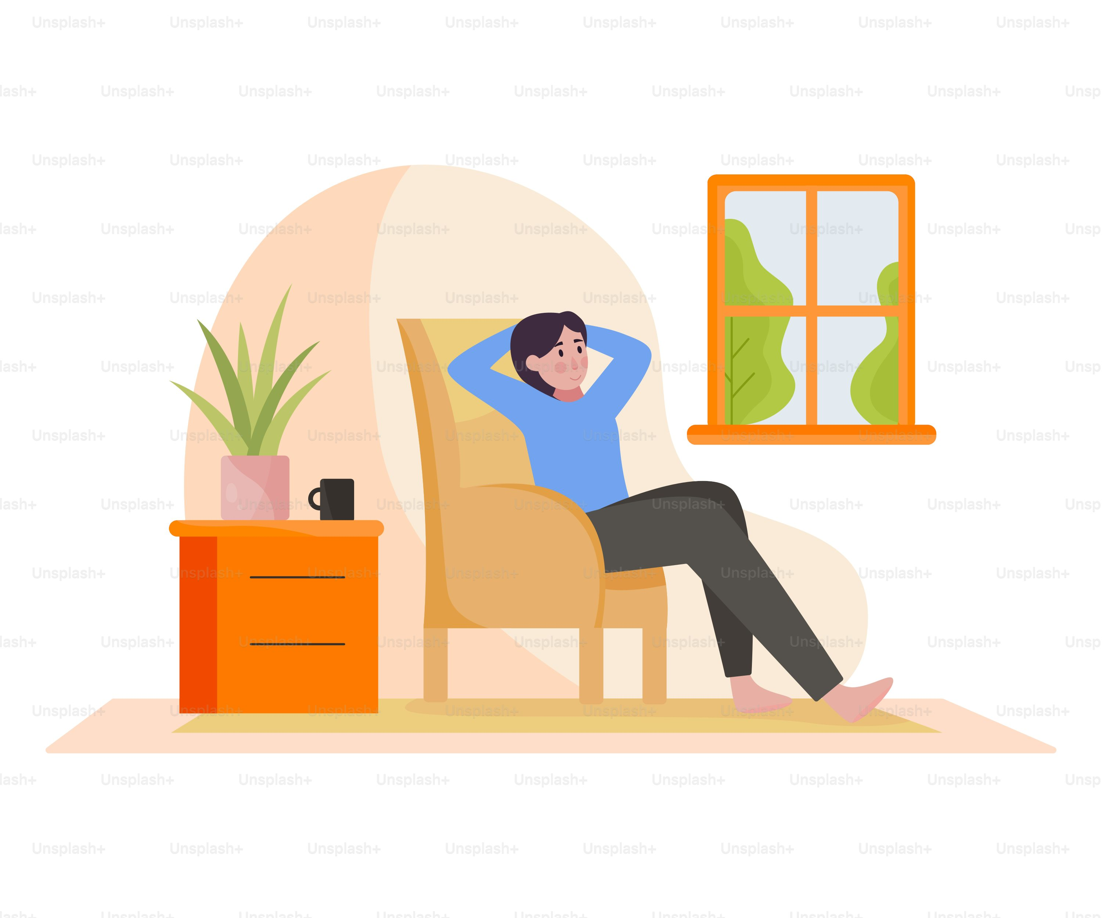
1) Pace yourself
It’s important to pace yourself to avoid running out of energy due to rushing and not resting!
Take breaks and rest. Avoid rushing – slow and steady wins the race.
Rest before you become tired – it will take longer to recover if you do not.
Notes:
Jared

Slide 8
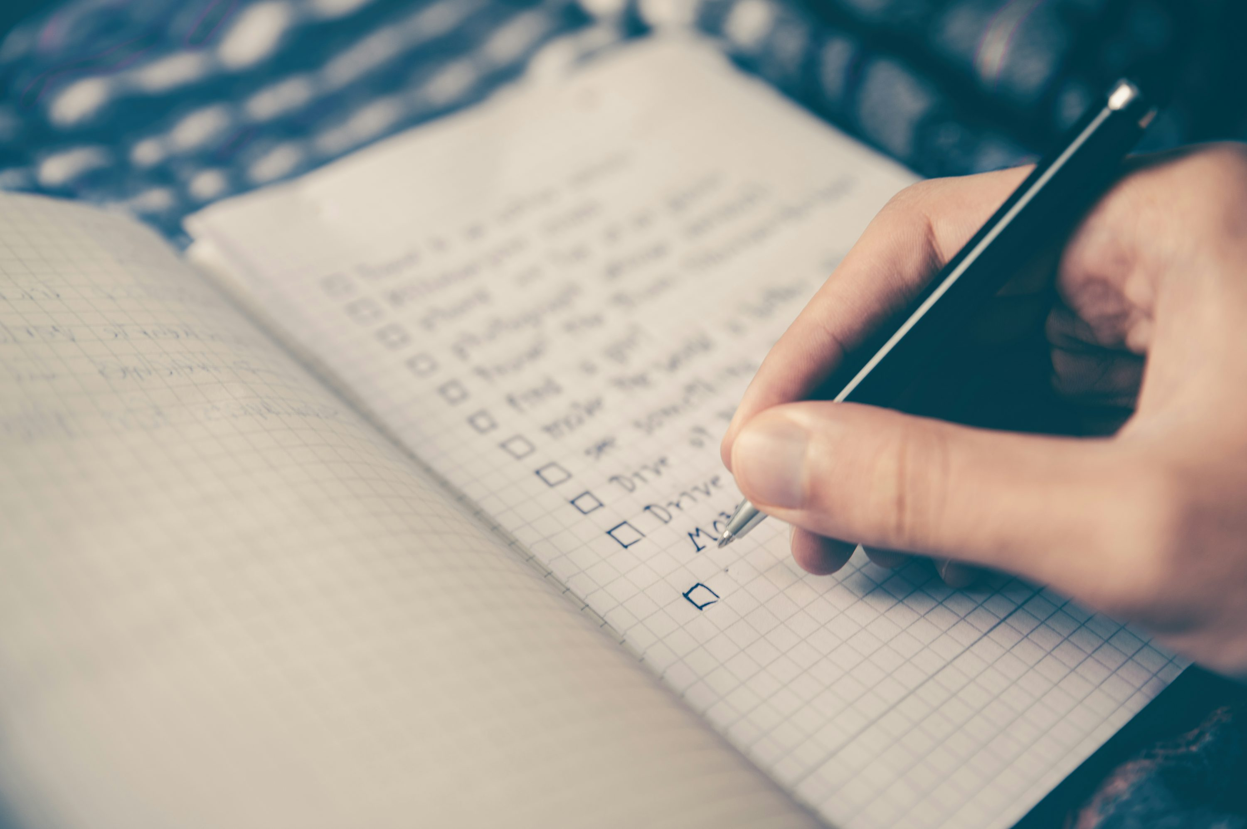
2) Plan ahead
A good plan allows one to feel more in control of their energy and ability to achieve all planned activities!
Plan your weekly tasks out and spread more tiring tasks throughout, not all at once.
Space out your activities: take breaks between.
Notes:
Jared

Slide 9
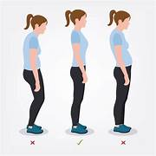
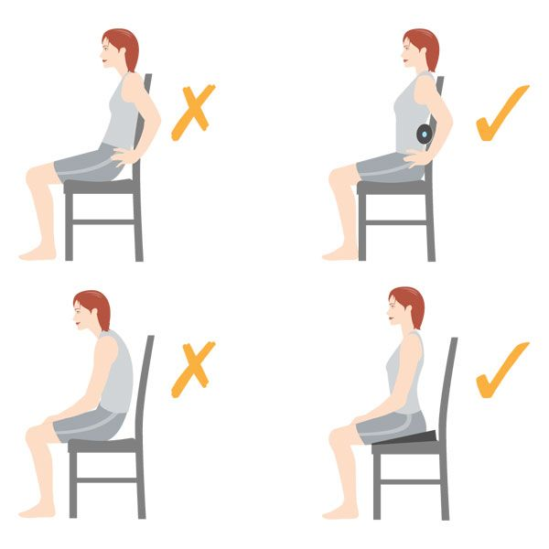
3) Position yourself
Certain positions allow for more effective breathing, and some cause more fatigue and use more energy than others!
Position yourself upright when sitting and standing.
Be aware that bending and reaching can cause shortness of breath.
Change positions often.
Group practice!
Notes:
Jared

Slide 10
4) Prioritize tasks
It’s helpful to plan which tasks are most important to complete, and ensure you save energy for these!
Organize activities from most to least important.
Do the most important tasks when you have the most energy.
Notes:
Jared

Slide 11
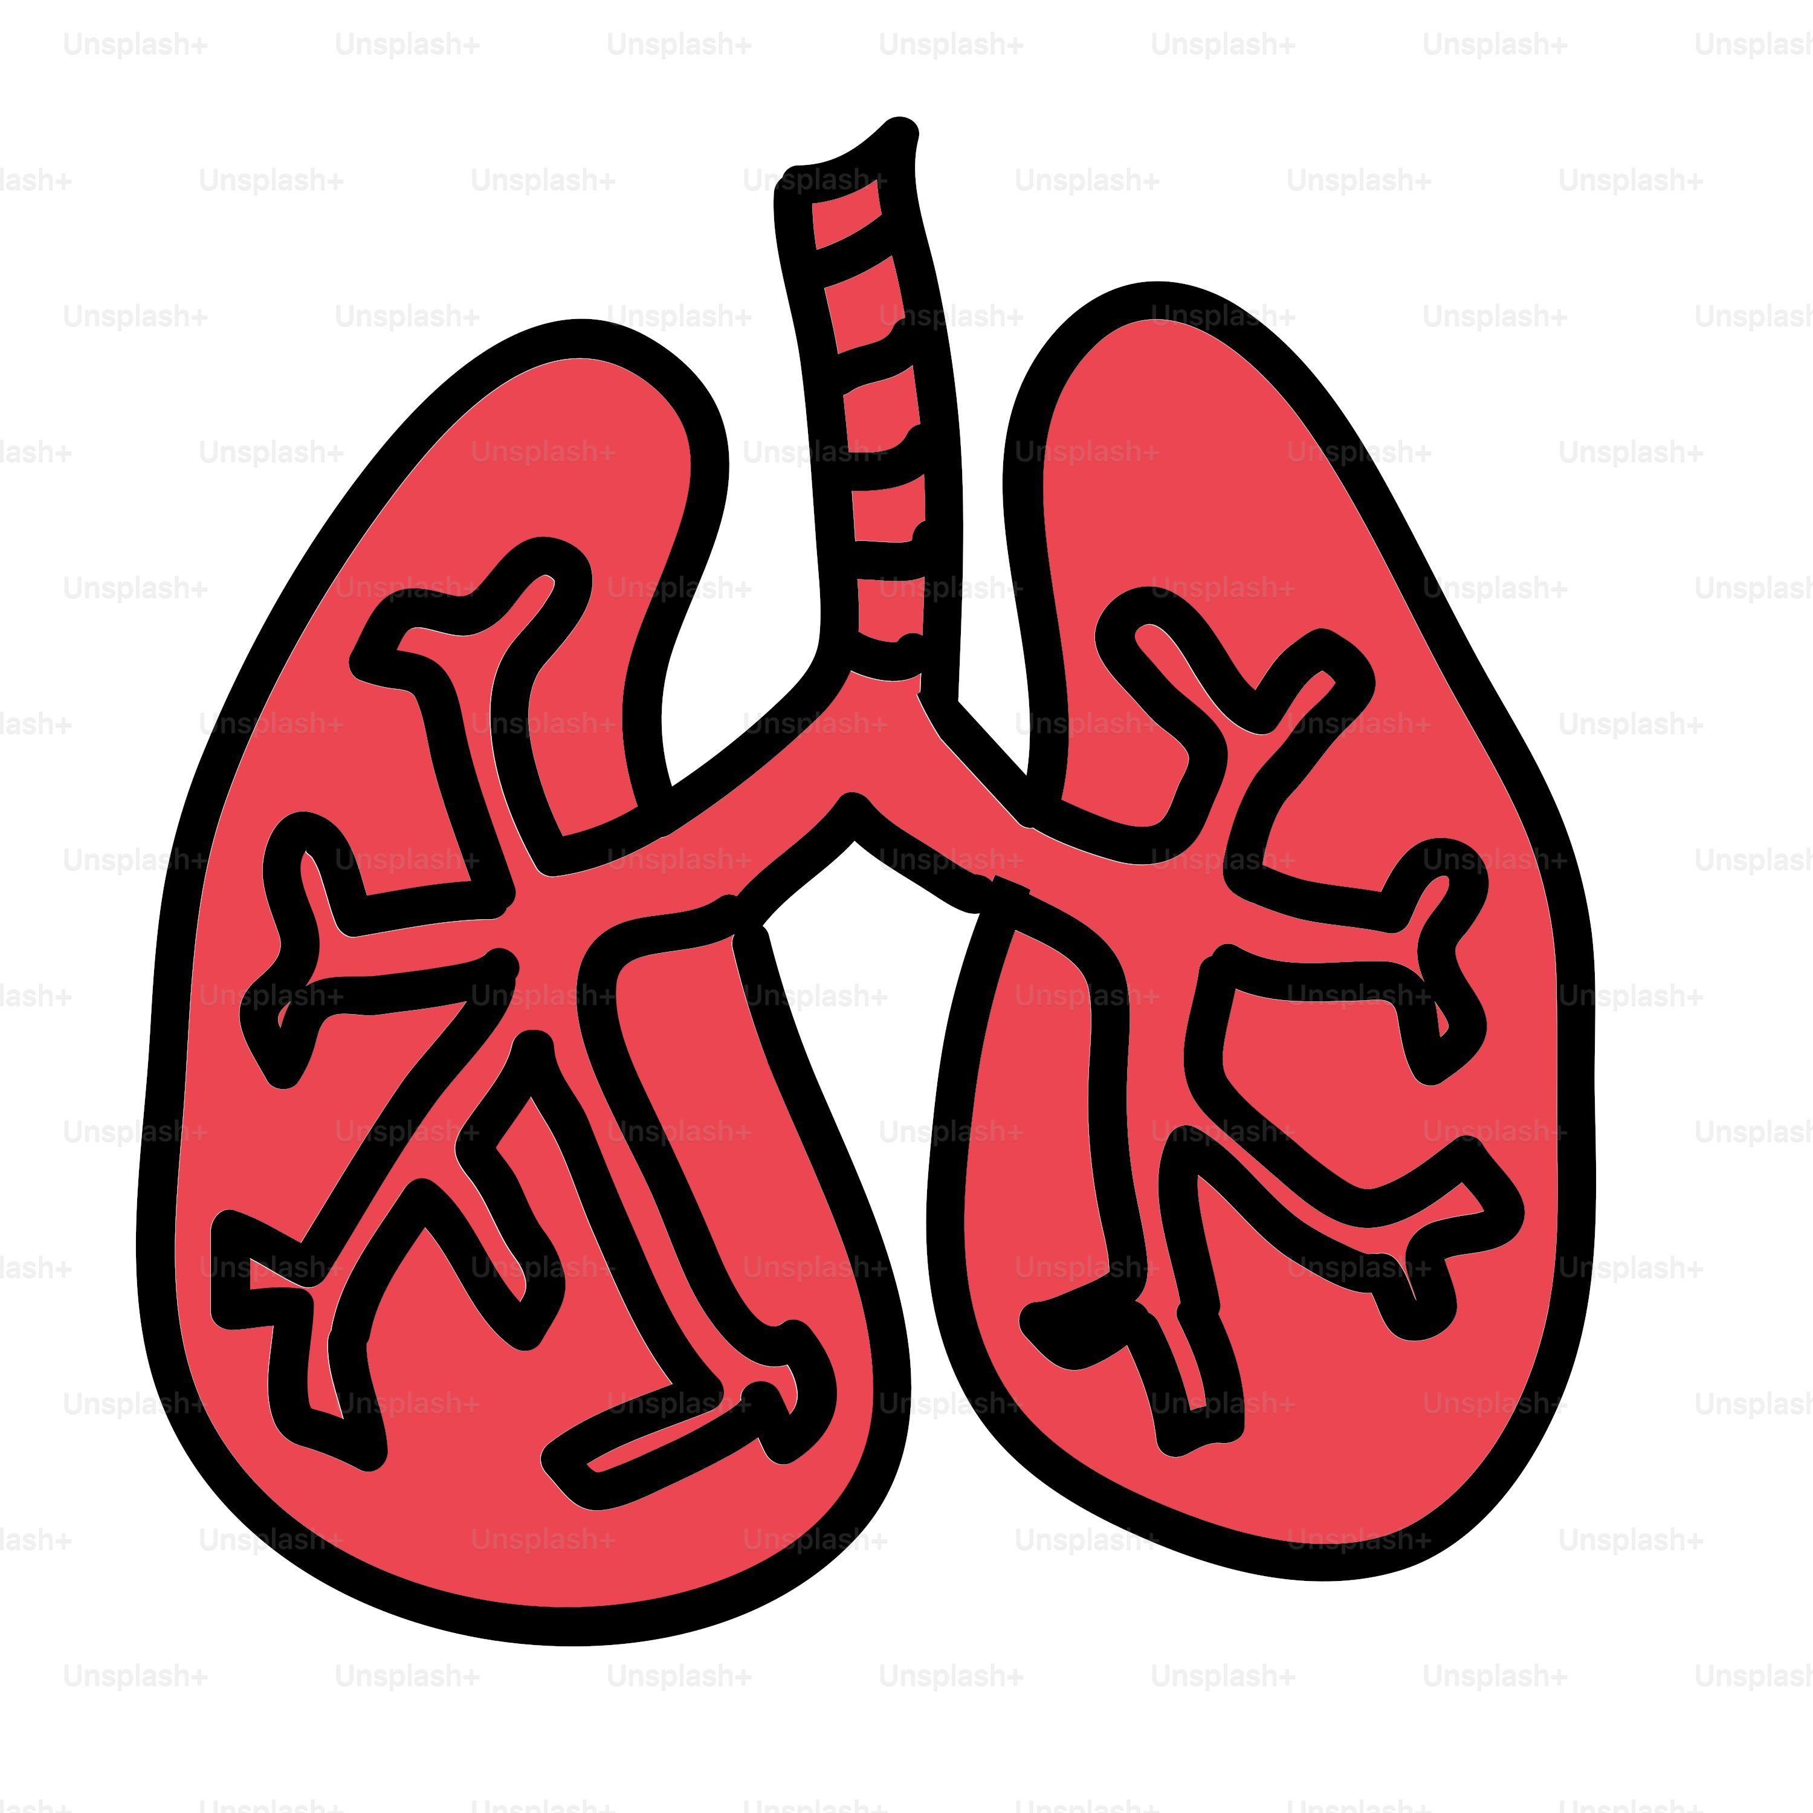
5) Pursed-lip breathing
Breathing exercises are useful tools in improving effectiveness and reducing effort involved in breathing!
Exercise helps to slow down breathing and reduce ‘air-trapping’ (when you struggle to empty air from your lungs).
Practice daily and will become natural.
Demonstration to come!
Notes:
Jared

Slide 12
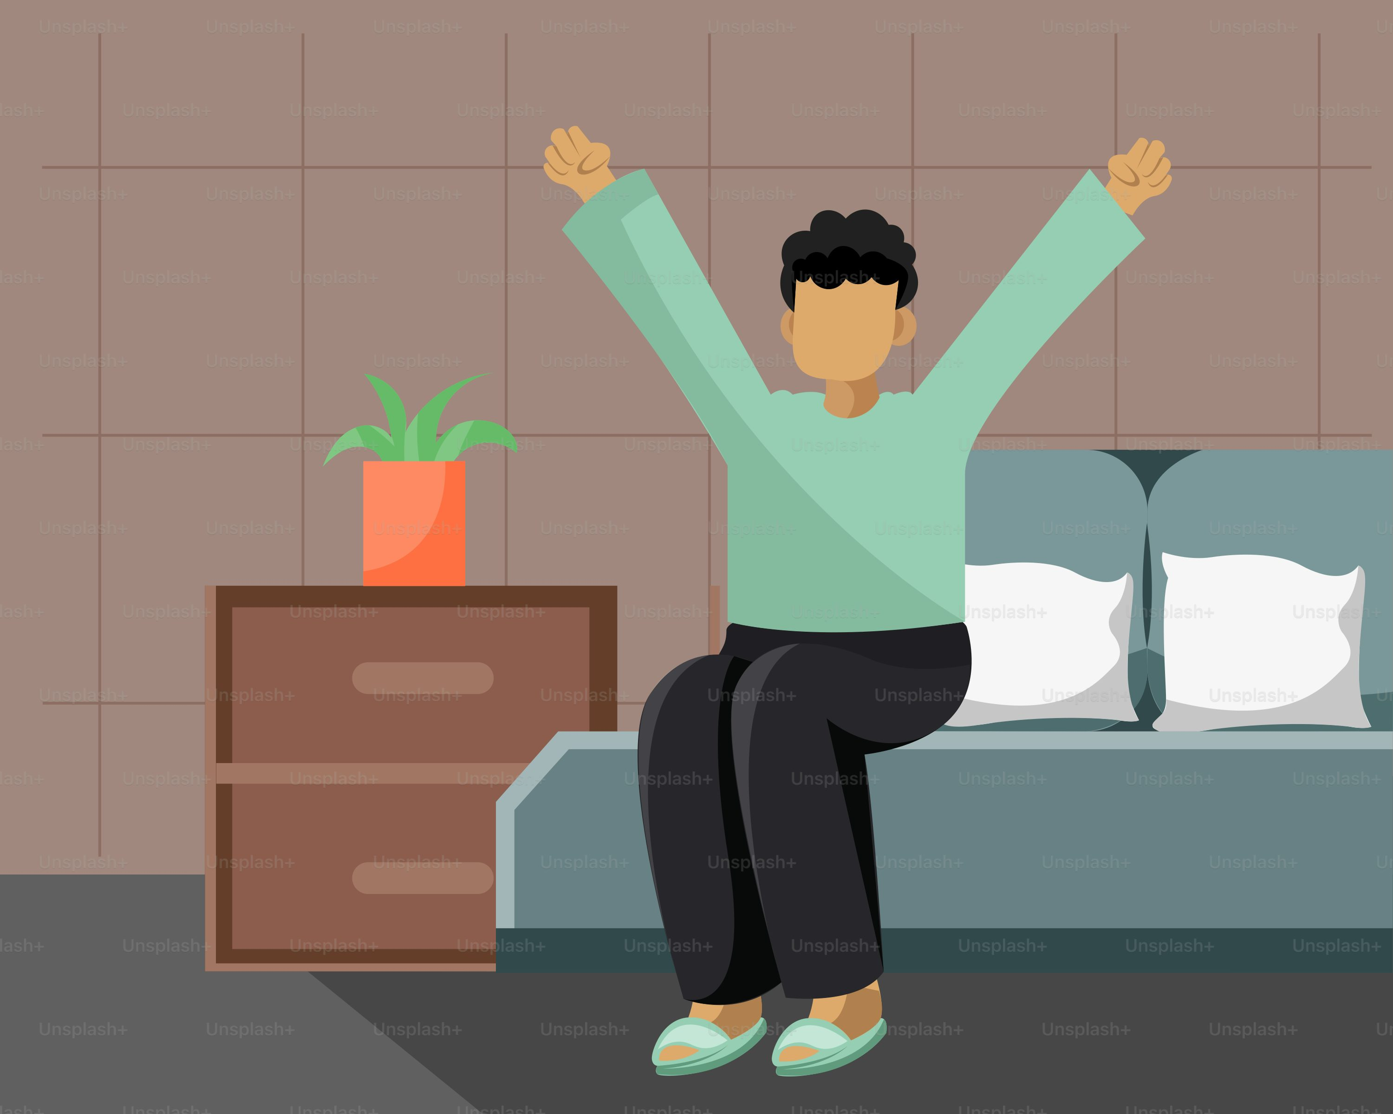
Tips for Managing Activities
There are different strategies for managing energy during your activities of daily living (ADL’s), here are a few:
Waking up:
Pace yourself in the morning
Rest and slow down as tasks are completed
Talk to your physician about when to take daily medications; especially if you have symptoms when waking up
Bathe or shower in evening to reduce activities in the morning
Lay out clothing in the evening so you have one less task in the morning
Notes:
Joyce

Slide 13
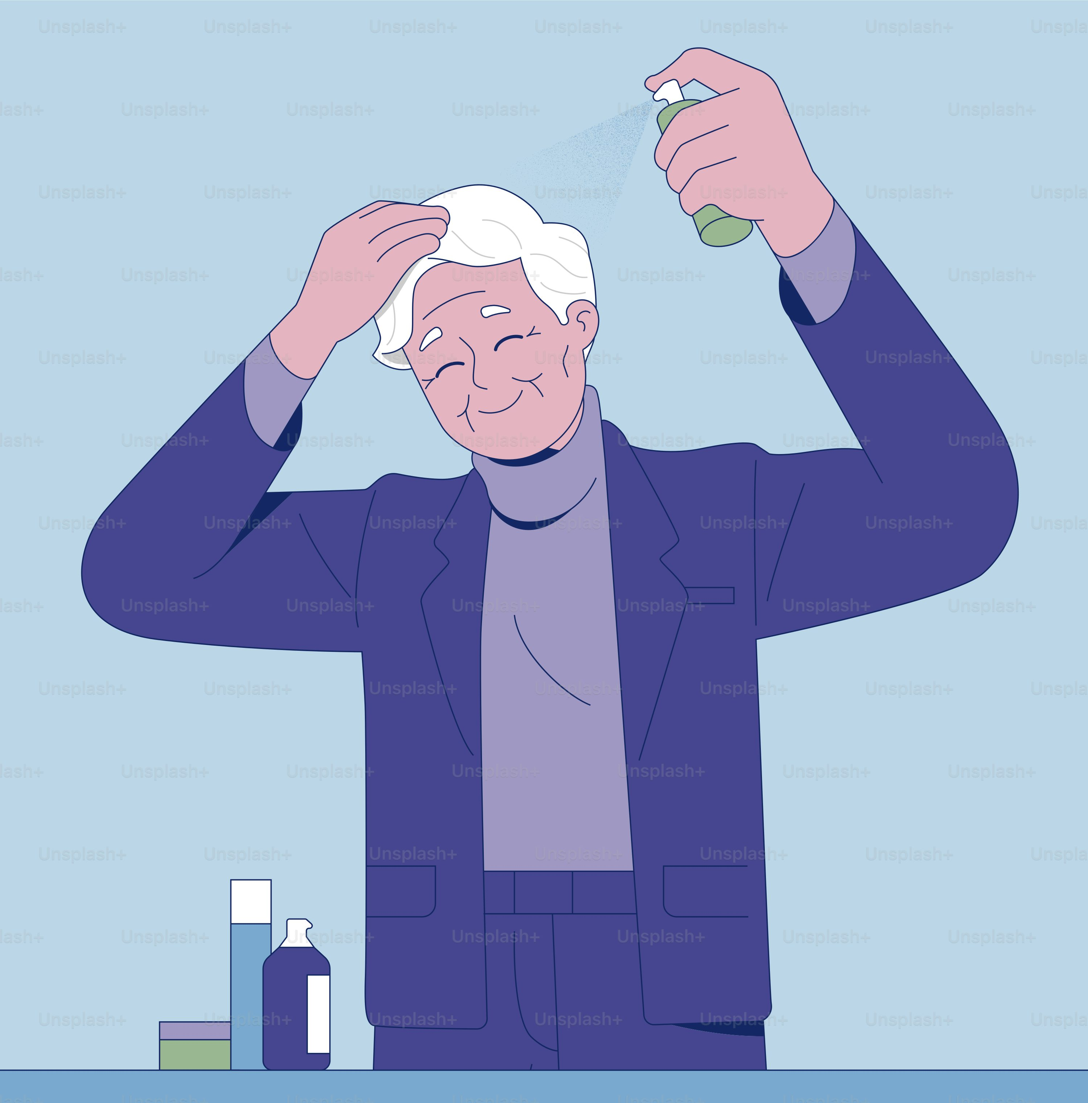
Tips for Managing Activities
Dressing, Bathing, and Grooming:
Assistive devices (handheld showerhead, shower chair, and grab bars) may be helpful
Reduce excess humidity and steam – use a fan or crack open the bathroom door, reduce temperature of room.
Use scent-free products if this triggers shortness of breath.
Sit down when able (ex: hair, makeup, shaving)
Wear shirts with buttons or zippers to avoid pulling them over your head
Use a terry towel robe to dry off after bathing
Notes:
Jared

Slide 14
Tips for Managing Activities
Walking and Climbing Stairs
Breath out as you take a step
Pace yourself
Rest and use pursed-lip breathing when short of breath
Try to keep items commonly used on the main level of your home to avoid excess trips on the stairs.
Notes:
Joyce

Slide 15
Tips for Managing Activities
Eating:
Eat small, frequent meals, instead of larger ones so you aren’t too full. Being too full can push on your diaphragm, a muscle that helps you breathe.
If you are too tired to eat, try small, higher-calorie, but healthy foods (ex: smoothies, or add cheese or peanut butter to snacks)
Notes:
Jared

Slide 16
Tips for Managing Activities
Medication Management:
Keep a record of daily meds taken and do so at the same time daily
Organize your medications (ex: weekly pill boxes or blister packages)
Store medications in an easily accessible place
Notes:
Joyce

Slide 17
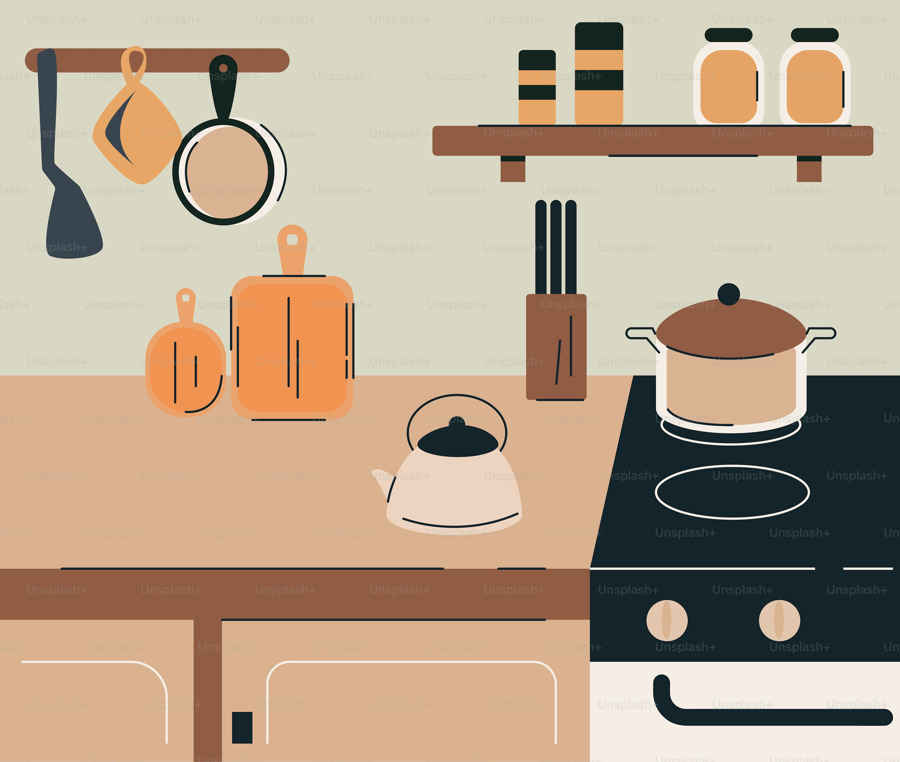
Tips for Managing Activities
Meal Preparation:
Sit down when able (ex: cutting or chopping)
Use a slow cooker or one pan at a time
Keep frequently used items in easily accessible locations
Rest before cleaning up after meals
Utilize a dishwasher or air-dry dishes when able
Notes:
Jared

Slide 18
Tips for Managing Activities
Housekeeping Chores:
Plan a schedule for the week and ensure you rest
Plan cleaning for when you have the most energy
Pick up items with a reaching aid
When possible, sit to complete tasks (ex: folding laundry)
Use a wheeled cart to move items
Notes:
Joyce

Slide 19
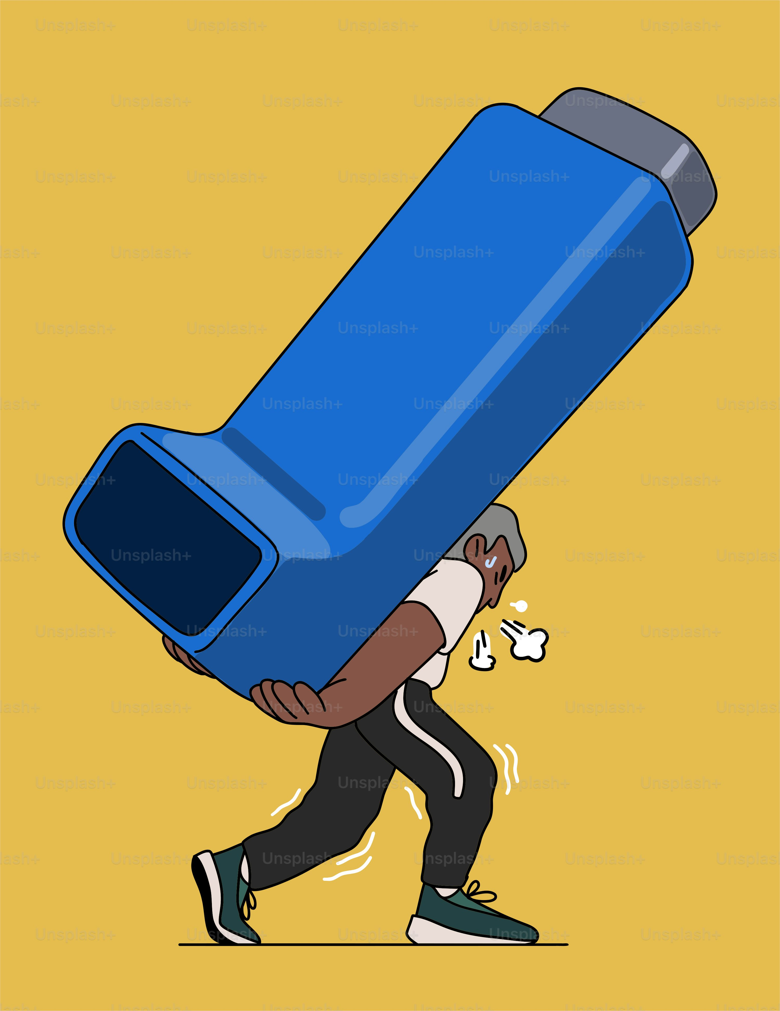
Tips for Managing Activities
Shopping:
ALWAYS bring your reliever medications and enough oxygen for your trip
Use the mobility device recommended for you
Visit stores during the least busy hours (reduce waiting times and sense of being rushed)
Use a shopping cart to position yourself and lean against when needed for rest
Utilize grocery delivery companies when needed
Notes:
Jared

Slide 20
Demonstration of Breathing Exercise: Pursed-lip Breathing
Purse-lip breathing is a breathing technique that reduces airflow limitation and gas trapping, which causes shortness of breath, associated with chronic lung disease.
Steps:
Inhale slowly through your nose
Purse lips as if you are blowing a candle or whistling
Exhale slowly through your mouth with pursed lips
*Exhale for twice as long as you inhaled
i.e., if you inhale for two seconds, exhale for four seconds.
Notes:
Jared

Slide 21
Activity: Group Pursed-lip Breathing Practice
Notes:
Jared and Joyce (Shared)

Slide 22
Activity: Share your Strategies
GROUP SHARE:
Does anyone have a strategy that works for them and would like to share with the rest of the group?
Notes:
Joyce

Slide 23
Questions?
Comments?
Clarification?
Notes:
Jared

Slide 25
References
American Lung Association. (2024). Conserving Energy and Managing Your Daily Activities. American Lung Association. https://www.lung.org/lung-health-diseases/lung-disease-lookup/copd/living-with-copd/daily-activities
Health Link British Columbia. (2022). Content map terms. Conserving Energy When You Have COPD or Other Chronic Conditions https://www.healthlinkbc.ca/illnessesconditions/copd/conserving-energy-when-you-have-copd-or-other-chronic-conditions
Living Well with COPD. (2025). Living well with a chronic obstructive pulmonary disease - COPD. LWWCOPD. https://www.livingwellwithcopd.com/en/home.html
RESPTREC® respiratory training and educator course. Lung Sask. (2025). https://www.resptrec.org/itinerary/itineraryOnline.php?currMenu=My%2BLearning%2BCentre
Images:
https://putneyclinic.co.uk/good-posture-sit-tall/
https://motionptg.com/location/motion-maspeth/
https://unsplash.com/

